Slide 1

Beam Deflection Simulation
Notes:
Beam Deflection Simulation

Slide 2
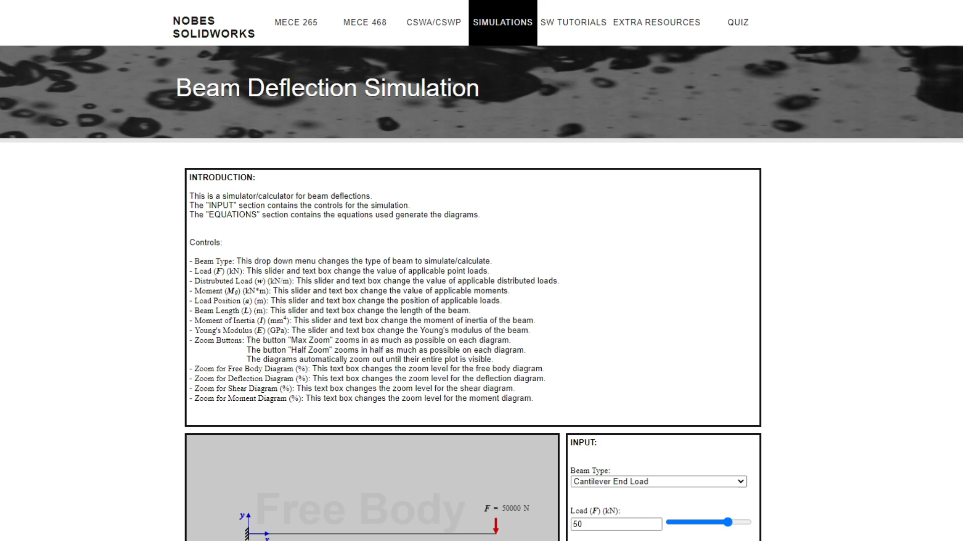
Introduction
Notes:
In engineering, beam deflection is a fundamental concept, but students may find it difficult to visualize. The goal of this simulation is to help students visualize how different variables affect deflection, shear, and bending moment diagrams for different beam-deflection-scenarios.

Slide 3
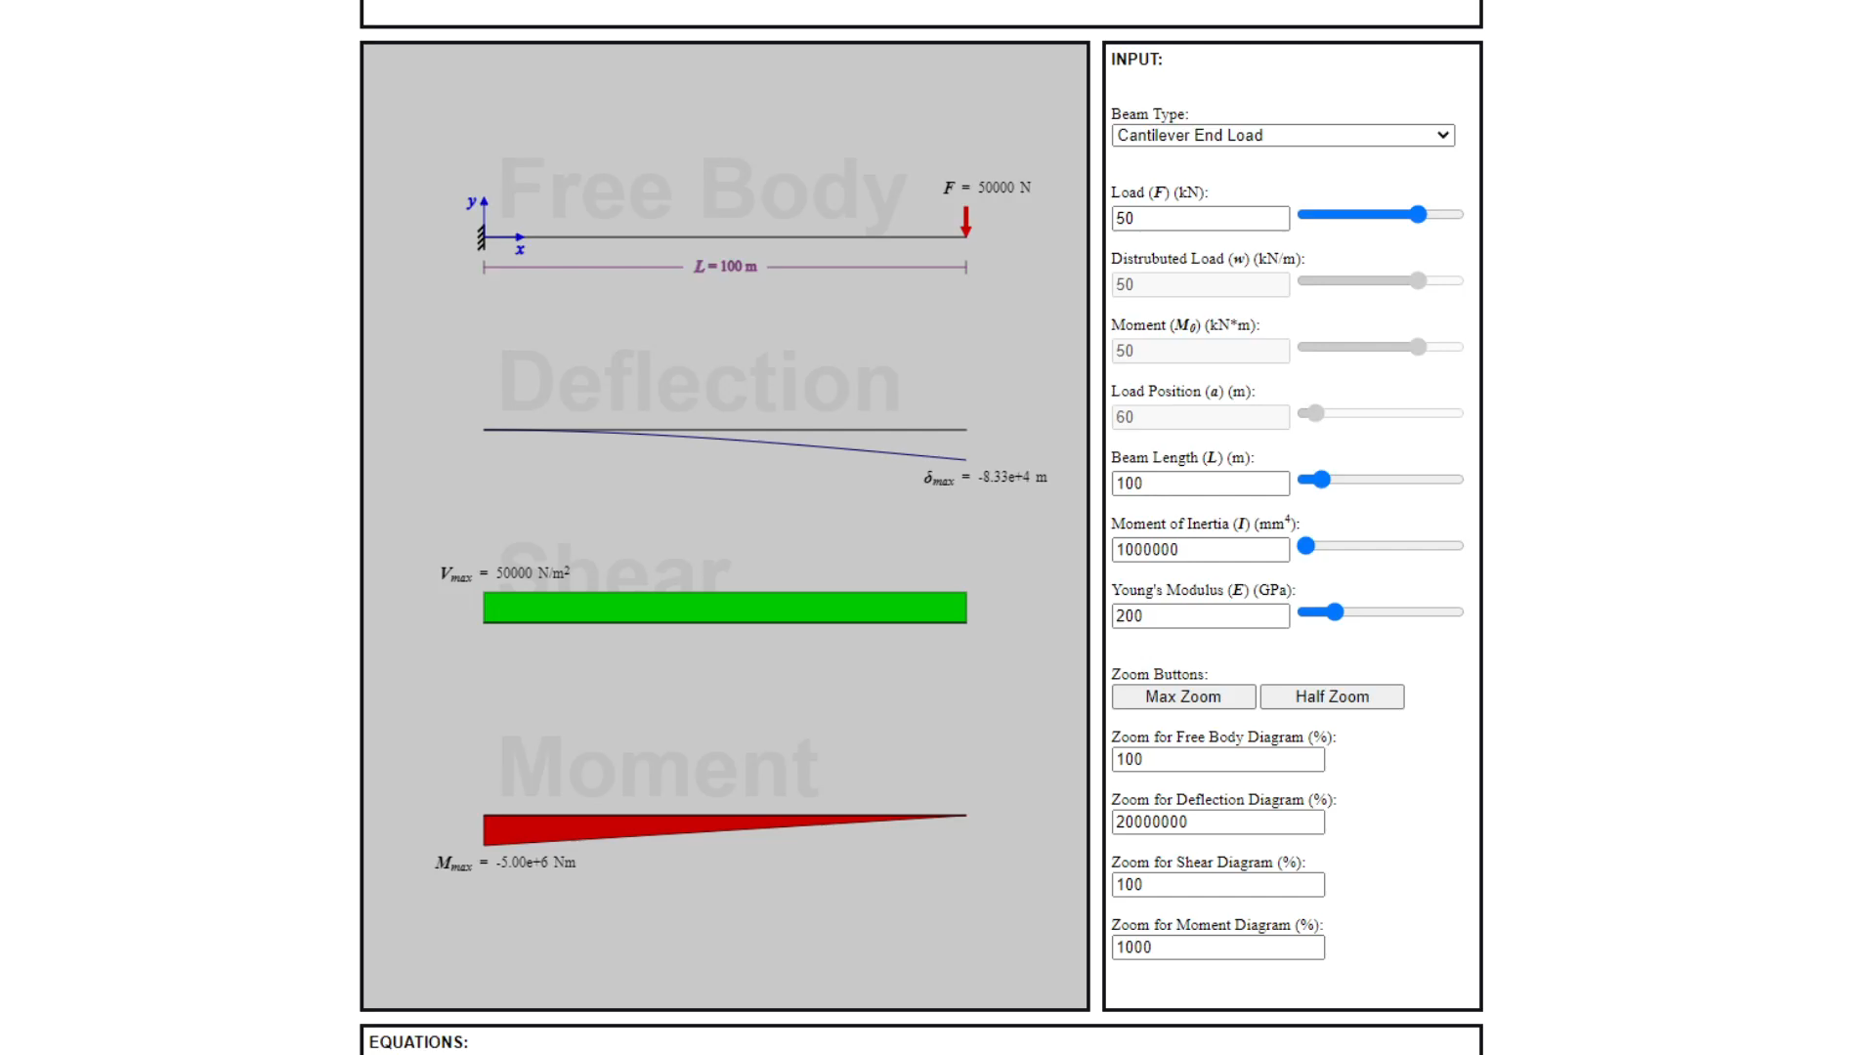
Controls
Notes:
Controls. The diagrams are controlled by the interactive elements in the box titled “input”. The “beam type” drop-down-menu will change the beam-deflection-scenario simulated by the diagrams. The text-box and slider pairs each control a single variable. If a text-box and slider pair is grey, the variable it controls is not relevant to the selected beam-deflection-scenario. The “zoom” buttons adjust the scale of the diagrams so that the plots are clearly visible. Below the “zoom” buttons are four text-boxes that control the scale of each specific diagram. The diagram plots have upper and lower limits. The diagrams automatically zoom out when their plots are too big to be displayed.

Slide 4
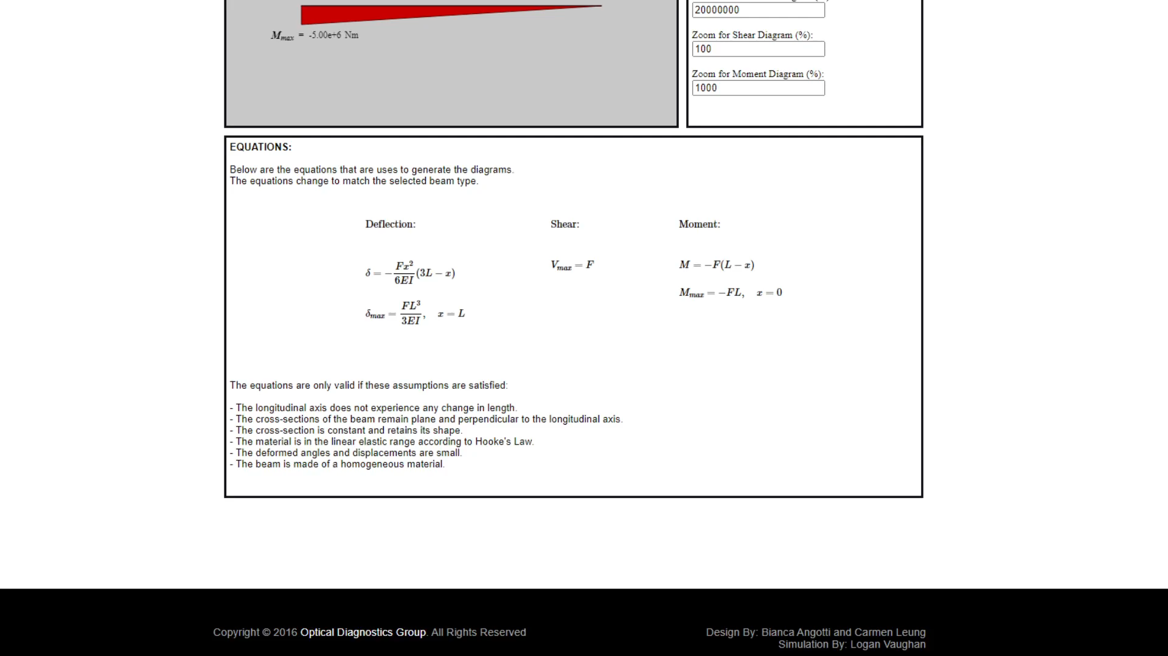
Calculations
Notes:
Calculations. The equations that are used to plot the diagrams for the selected beam-deflection-scenario are displayed in the box titled “equations”. These equations will change whenever another beam-deflection-scenario is selected. The box titled “equations” also contains a list of assumptions that must be satisfied if the equations, and, therefore, the simulation itself, is to be considered valid.

Slide 5
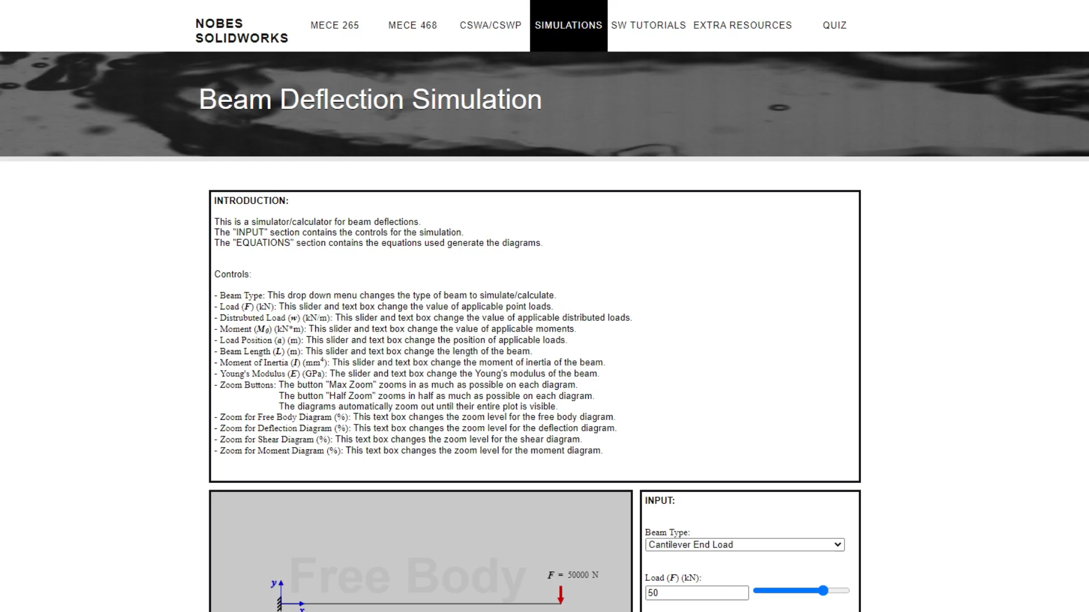
Conclusion
Notes:
Play around with the simulation and familiarize yourself with the equations to further your understanding of beam deflection, and the relating deflection, shear, and moment diagrams.

